Slide 1
SOFTWARE REQUIREMENTS ENGINEERING
LECTURE # 5
TEAM SKILL 2: UNDERSTANDING USER AND STAKEHOLDER NEEDS
REQUIREMENT ELICITATION TECHNIQUES-II
Engr. Ali Javed
18th May, 2013

Slide 2
Presentation Outline
3
Requirements Workshop
Participants of Requirements Workshop Benefits of Requirements Workshop
Preparation for Workshop Role of Facilitator Workshop Agenda Running the Workshop Brainstorming
Roles for Brainstorming
Objectives of Brainstorming Phases of Brainstorming
Idea Generation
Idea Reduction Rules Of Brainstorming
Live Brainstorming
Web based Brainstorming
•
•
•
•
•
•
•
•
•
•
•
•
•

Slide 3
Requirements Elicitation Techniques
4
Interviews
Questionnaires
Background Reading
Introspection
Social Analysis
Requirements Workshops
Brainstorming and Idea Reduction
Story Boarding
Role Playing
Prototyping
Requirements Reuse
Engr. Ali Javed

Slide 4

Requirements Workshop
5
A requirements workshop is a structured, assisted and collaborative event in which a selected
group of stakeholders work together to discover, create, verify and document requirements,
deliverables and work products
The requirements workshop is perhaps the most powerful technique for eliciting requirements.
It gathers all key stakeholders together for a short but strongly focused period.
The use of an outside facilitator experienced in requirements management can ensure the success of the workshop.
Brainstorming is the most important part of the workshop.
Engr. Ali Javed

Slide 5

Participants of Requirements Workshop
6
Sponsor
May not attend each workshop but might kick off the initial workshop
Content Participants
Subject matter experts and user representatives
Facilitator
Neutral skilled person who designs and lead the workshop
Recorder
Neutral person experienced in documenting the specific work product
This role can be filled by an analyst, developer, tester, Project manager
Planning Team
A minimum of three people- a content participant, a technical member (can be analyst) and facilitator
Engr. Ali Javed

Slide 6
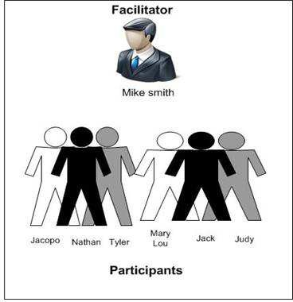
What happens in Requirements Workshop
7
Team members create, review and complete important requirements deliverables
The facilitator manages the group’s process
The Recorder documents the group’s work as its proceeds
Engr. Ali Javed

Slide 7

Benefits of Requirements Workshop
8
20% to 50% reduction in overall product defects
Scope creep decrease from 80% to 10% or even 5% when workshops are combined with prototyping
5-15% time and effort savings
You can get the inputs of all the stakeholders
The functionality of the application is decided between the stakeholders and the
manufacturers at early stage
Engr. Ali Javed

Slide 8

Accelerating the Decision process
9
The more elicitation and requirements gathering techniques the team has in their toolkit, the more effective the team will be.
Mostly the team does not have the luxury of time to either master or apply a variety of
techniques. They have to pick one technique and go.
If we have to apply one requirements elicitation technique in every circumstance, independent of project context and time frame then we would pick the requirements workshop
The requirements workshop is designed to encourage agreement on the requirements of the application in a very short time.
key stakeholders of the project gather together for a short, concentrated period, typically no more than one or two days.
Engr. Ali Javed

Slide 9

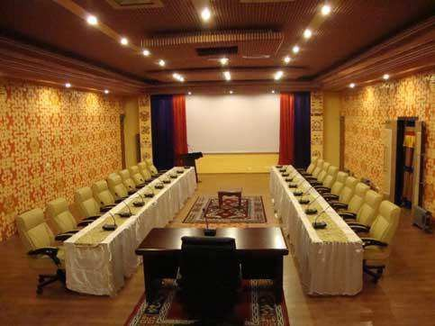
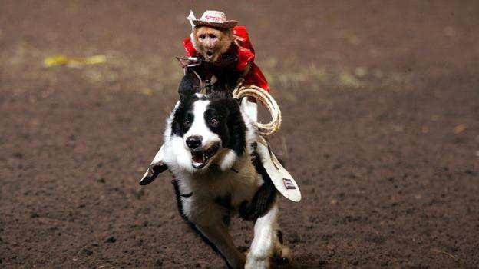
Preparing for the Workshop
10
“Proper preparation for the workshop is critical to success.”
Selling the workshop concept to stakeholders
Ensuring the Participation of the Right
Stakeholders
Attending Logistics
Logistics involve everything from structuring the proper invitation to travel arrangements to the lighting in the workshop meeting room.
Preparation of Warm-up materials
Project-specific information
Out-of-box thinking preparation
Engr. Ali Javed

Slide 10

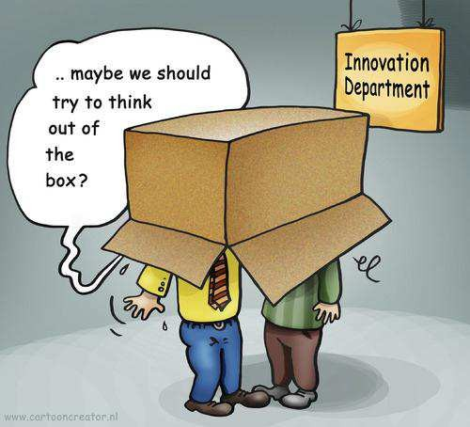
Warm-up Materials
11
Project-specific information
This might include drafts of requirements documents, suggested features, copies of interviews, analyst's reports on industry trends, bug reports from existing system, new management orders, new marketing data, and so on. Although it's important not to bury the attendees in data, it's also important to make sure they have the right data.
Out-of-box thinking preparation
Part of "getting their minds right" is encouraging attendees to think "out of the box." "Forget for a minute what you know and what can't be done due to politics. Forget that we haven't yet standardized our development process. Simply bring your insights on the features of this new project, and be prepared to think 'out of the box.'"
Engr. Ali Javed

Slide 11

Role of the Facilitator
12
Establish professional and objective tone to the meeting.
Start and stop the meeting on time.
Establish and enforce the “rules” for the meeting.
Introduce the goals and agenda for the meeting.
Manage the meeting and keep the team “on track.”
Facilitate a process of decision and consensus making, but avoid participating in the content.
Make certain that all stakeholders participate and have their input heard.
Control troublesome or unproductive behavior.
Engr. Ali Javed

Slide 12

Workshop Agenda
13
Set an agenda before the workshop and publish it along with the other pre- workshop documentation.
Balance is the key, try to stay on the agenda, but do not strictly obey it, especially if good discussion is going on.
Engr. Ali Javed

Slide 13

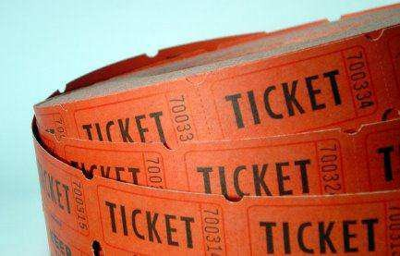
Running the Workshop
14
Allow for human behavior, and have fun with it.
Do not “attack” other members.
Do not get on a soap box.
Do not come back late from a break.
Workshop tickets
Give every stakeholder workshop tickets
1 for being late
1 for “cheap shot”
1 for “soap box” [5 min position statement]
2 for great ideas
Engr. Ali Javed

Slide 14
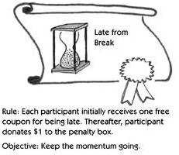
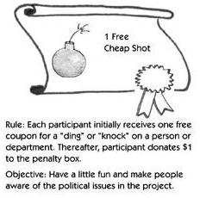
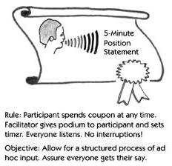
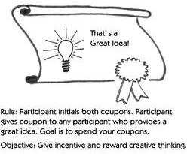
Running the Workshop
15
Engr. Ali Javed

Slide 15
Workshop Problems and Suggestions
16
Problem | Suggestions
Time Management It’s difficult to get going after breaks and lunch Key shareholders may be late returning | Facilitator keeps a timer for all breaks and Fines anyone that is late, everyone gets one Free pass
Grand standing, dominant positions | Everyone gets one 5 minute position statement.
Lack of input from stakeholders | Facilitator encourages everyone to use 5- Minute position and great idea ticket.
Negative comments, irrelevant behaviors, and turf wars | Use “Cheap Shot Tickets”, all others cost money.
Fading energy after lunch | Light lunches, afternoon breaks, rearrange seating
Engr. Ali Javed

Slide 16

Brainstorming
17
Brainstorming is a group technique for generating new, useful ideas and promoting creative thinking for finding the solution to a specific issue
This is conducted as a conference with six to ten members
The members are from the different departments and domain experts are also included
This conference is headed by the organizer, who states the issue to be discussed
The Conference is generally held in a round table fashion
Engr. Ali Javed

Slide 17

Brainstorming
18
Every team member is allotted a certain time interval to express and explain their ideas
Notepads are provided to all members to write their ideas and suggestions
The team of Brainstorming will then decides the best idea by voting from the group
and that idea is selected as the solution to the issue discussed in the conference
Engr. Ali Javed

Slide 18

Brainstorming
19
It can be used to help
elicit new ideas and features for the application
define what project or problem to work on,
to diagnose problems ,
Identify possible solutions and resistance to proposed solutions
Engr. Ali Javed

Slide 19

Roles
20
There are three roles for participants in a brainstorming session:
Leader -This person needs to be a good listener,
Scribe -This person needs to write down EVERY idea – clearly and where
everyone in the group can see them and
Team member - participants
Engr. Ali Javed

Slide 20

Brainstorming
21
Typically, a portion of the workshop is devoted to brainstorming new ideas and features for the application.
Brainstorming elicitation technique has a number of benefits.
It encourages participation by all parties present.
It allows participants to "piggyback" on one another's ideas.
It has high bandwidth. Many ideas can be generated in a short period of time.
The results typically indicate a number of possible solutions to whatever problem is posed.
It encourages out-of-the-box thinking, that is, thinking unlimited by normal constraints
Engr. Ali Javed

Slide 21

Phases of Brainstorming
22
Brainstorming has two phases: idea generation and idea reduction.
Idea generation
The primary goal during idea generation is to set down as many ideas as possible, focusing on breadth of ideas, not necessarily depth.
Idea reduction
The primary goal during idea reduction is to analyze all the ideas generated.
Idea reduction includes pruning, organizing, ranking, grouping, refining, and so on.
Engr. Ali Javed

Slide 22
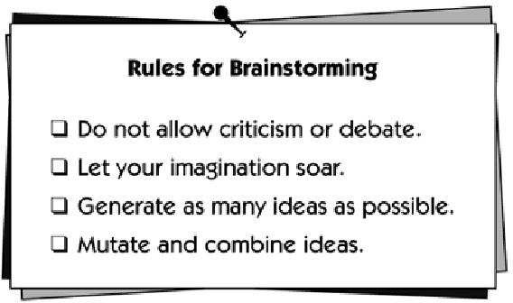




Rules of Brainstorming
23
First, all the significant stakeholders gather in one room, and supplies are distributed.
Then the facilitator explains the rules for brainstorming.
Ascending to a level markedly higher than the usual
Change Or Modify
Engr. Ali Javed

Slide 23

Objective of Brainstorming
24
The facilitator
also explains the the process. The
objective of
following questions are
a few ways
to state the objective.
What features would you like to see in the product?
What services should the product provide?
What opportunities are we missing in the product or the market?
After stating the objective of the process, the facilitator asks participants to share their ideas aloud and to write them down, one per sheet
Engr. Ali Javed

Slide 24

Idea Generation
25
HOW ….. ?
Engr. Ali Javed

Slide 25

Idea Generation
26
When a person comes up with an idea, he or she writes it down on the supplied materials. This is important for the following reasons:
To make sure the idea is captured in that person's own words
To make sure ideas are not lost
To enable posting of piggybacking
To prevent delays
ideas
for later
in the creative
process that could be caused by a single
writer trying to capture all ideas
Engr. Ali Javed

Slide 26

Idea Generation
27
As ideas are generated, the facilitator collects them
and posts them on a wall in the meeting room.
Again, no criticism of ideas can be tolerated.
It is inappropriate to say, "That's a stupid idea," or even,
“We already have that idea on the wall. "
The sole purpose is to generate ideas.
The process tends to have a natural end; at some point, the stakeholders will simply run out of ideas.
Engr. Ali Javed

Slide 27

Idea Reduction
28
Pruning Ideas
Grouping Ideas
Defining Features
Prioritizing Ideas
Engr. Ali Javed

Slide 28


Idea Reduction
29
1. Pruning Ideas
The first step is to "prune" those ideas that are not worthy of further investment by the group.
The facilitator asks the participants whether each idea is worthy of further consideration and then removes an invalid idea
The presence of ideas that can be easily pruned is an indicator of a quality process.
Engr. Ali Javed

Slide 29
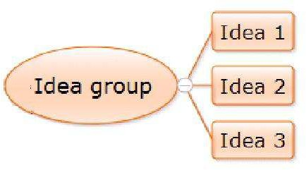
Idea Reduction
30
2. Grouping Ideas
It may be helpful during this process to start grouping similar ideas
Name the groups of related ideas. For example,
New features
Performance issues
Enhancements to current features
User interface and ease-of-use issues
Engr. Ali Javed

Slide 30

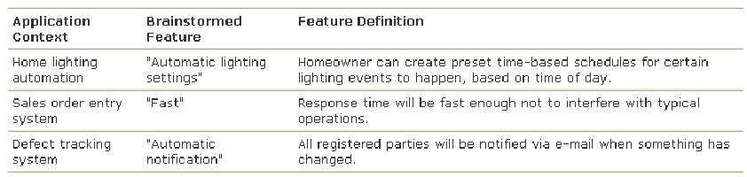
Idea Reduction
31
3. Defining Features
In this process, the facilitator walks through each idea that has not been pruned and asks the submitter to provide a one-sentence description.
This gives the contributor the opportunity to further describe the feature and helps ensure that the participants have a common understanding of the feature.
Examples:
Engr. Ali Javed

Slide 31
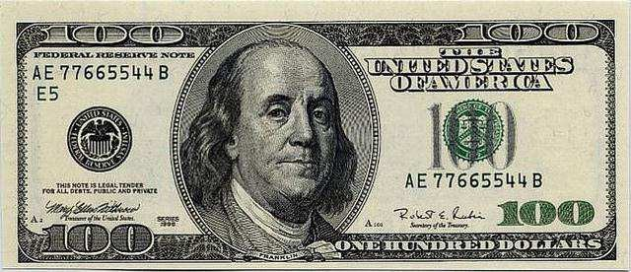
Idea Reduction
32
4. Prioritizing Ideas
Once the groupings of ideas have stabilized, the ideas should be prioritized since it is unlikely that all can be implemented (at least in the first release).
Two ideas for prioritization are:
Cumulative Voting: The Hundred-Dollar Test
The “Critical, Important, Useful” Categorization
Engr. Ali Javed

Slide 32
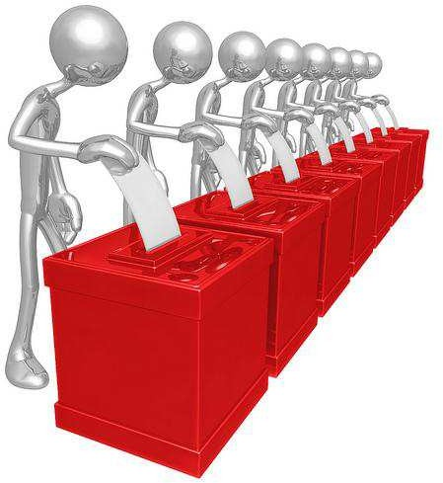
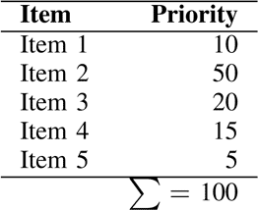
Idea Reduction
33
4. Prioritizing Ideas
Cumulative Voting: The Hundred- Dollar Test
Each member of the group is given $100 in “idea money” to be spent on purchasing ideas.
All participants write down on a piece of paper how much they are willing to spend on each idea they think is important (i.e., they vote with dollars).
The results are tabulated and the ideas are ordered based on the results.
It might be necessary to limit how much can be spent on a single idea.
Engr. Ali Javed

Slide 33

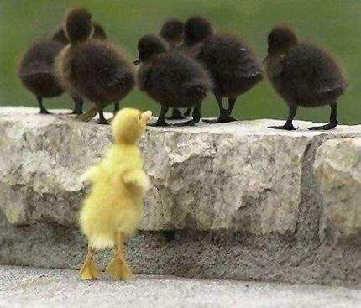
Idea Reduction
34
4. Prioritizing Ideas
"Critical, Important, Useful” Categorization
Each participant is given a number of votes equal to the number of ideas, one-third of which are “critical”, one-third are “important” and one-third are “useful”.
Each participant assigns one vote (critical, important, or useful) to each of the ideas.
The results are tabulated where a critical vote is given a value of 9, an important
vote is 3, and a useful vote is a 1.
The ideas are prioritized based on the computed sums.
Critical means that a stakeholder would not be able to use a system without this feature.
Important means that there could be a significant loss of customer utility, perhaps even market share or revenue, or new customer segments served without the feature.
Useful means nice to have.
Each stakeholder is given only one- third of the votes from each category.
Engr. Ali Javed

Slide 34
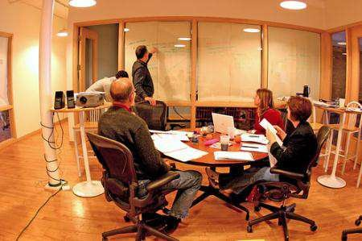
Live Brainstorming
35
All key stakeholders gather in one room.
Supplies are distributed consisting of large sticky notes and marking pens.
Facilitator explains rules and objective.
Engr. Ali Javed

Slide 35

Live Brainstorming
36
Facilitator asks participants to share their ideas aloud and write them down,
one idea per sheet.
They are stated out loud so others can “piggyback” their ideas. This process often gives rise to the best ideas.
No criticism or debate is allowed. If this rule is not enforced, some will be reluctant to contribute ideas.
When a person comes up with an idea, he or she writes it down
Idea generation should proceed until all participants feel it has reached a natural end.
Engr. Ali Javed

Slide 36

Web-Based Brainstorming
37
Sometimes live brainstorming is not possible.
In these situations, an alternative is to use the Internet or an intranet to facilitate the
brainstorming process in a collaborative environment
Engr. Ali Javed

Slide 37


For any query Feel Free to ask
38
Engr. Ali Javed

